Slide 1
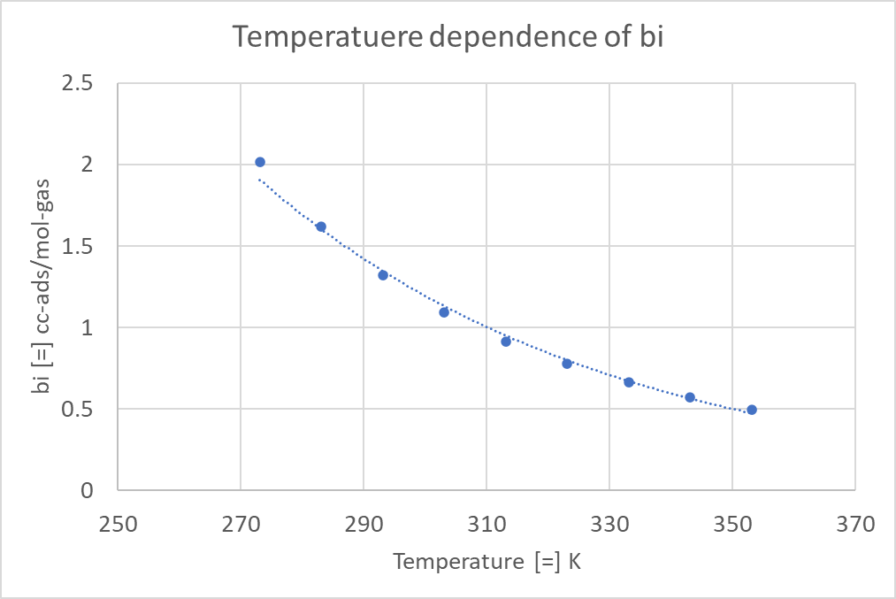
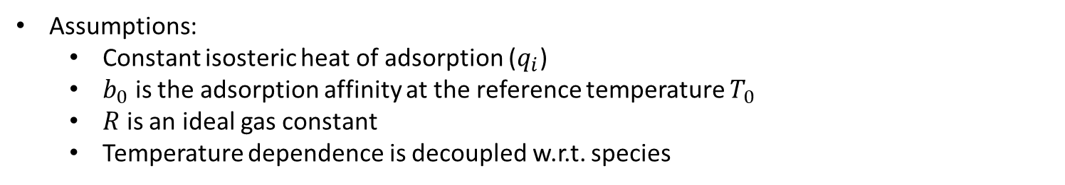
Temperature dependence of the isotherm parameter b, adsorption affinity constant.
Assumptions:
Constant isosteric heat of adsorption ($q_{i}$)
$b_{0}$ is the adsorption affinity at the reference temperature $T_{0}$
$R$ is an ideal gas constant
Temperature dependence is decoupled w.r.t. species

